Slide 1
A. P. Shah Institute of Technology
Color Code Substitution Based Advance Mailing Technique

Slide 2
Names of the Author & Co-Authors
Chinmay Karangutkar
Ankita Gound
Ameya Murkute
Prapti Nevrekar
Guide: Prof. Ganesh Gourshete

Slide 3
Outline of Presentation
Abstract
Introduction
Literature Review
Problem Statement
Proposed System
Technologies Used
Result Discussion
Conclusion

Slide 4
Abstract
Lately, exponential growth of technology in every aspect of life is observed. Improvement of technology provides facilities to both users and hackers/intruders too. Advancement in technology that encourages hackers/intruders activities result in lack of security to users condential data. The most common and popular techniques for data hiding that have been in use since long time are cryptography and steganography. Thus these email systems are also used on very large scale , many docs are been getting transferred via email systems, so this systems and servers should also be secured from all intruders and hackers as there is confidential data getting transferred via network, so it can be protected in most advanced and secure way ie: with help of triple encryption and steganography.

Slide 5
Intoduction
Nowadays there are many hackers present who can easily crack any system using advance hacking techniques.
Hackers can cost a lot of damage for the communication systems because the hacker can be able steal data which in under process of communication
In case of man in the middle attacks the hacker can spectate the overall activities carried out through the communication channel.
Steganography, the art of "hiding" some kind of secret information inside pictures, is very ancient technique of protecting data .

Slide 6
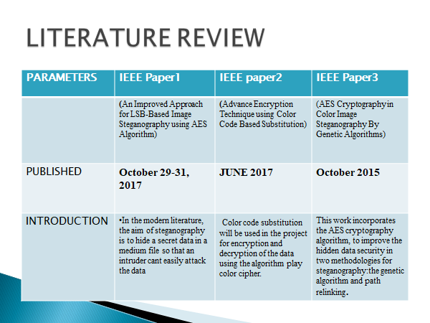

Slide 7
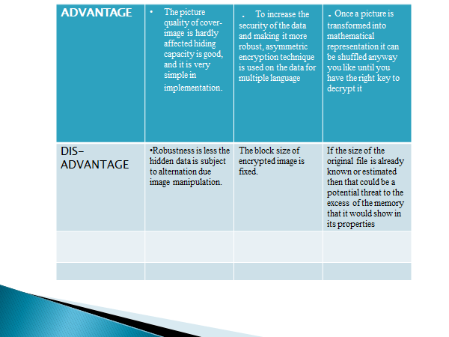

Slide 8
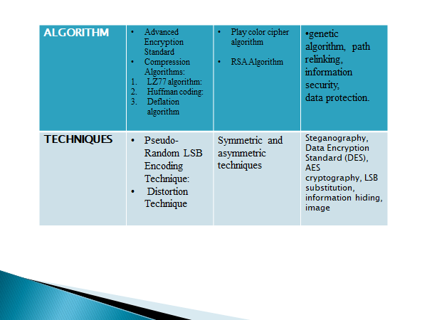

Slide 9
Problem Statement
To solve the current lack of highly encrypted mail service using triple encryption using steganography and multi language support for highly important or secret communication.
Man-in-the-Middle attack has became a biggest threat to mailing systems , here the attacker can steal the data and can also alter it when its been carried through communication medium.
In AMT we are going to use color-code substitution which will be hard for the attacker to identify the data from the Color blocks.
}Thus the above problem will be solved using AMT with the help of triple encryption and Steganography.

Slide 10
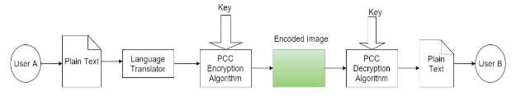
Proposed System
For Text

Slide 11
Solution description & Implementation
Now that you’ve justified your attention to the problem, summarize your solution in one or two sentences.

Slide 12
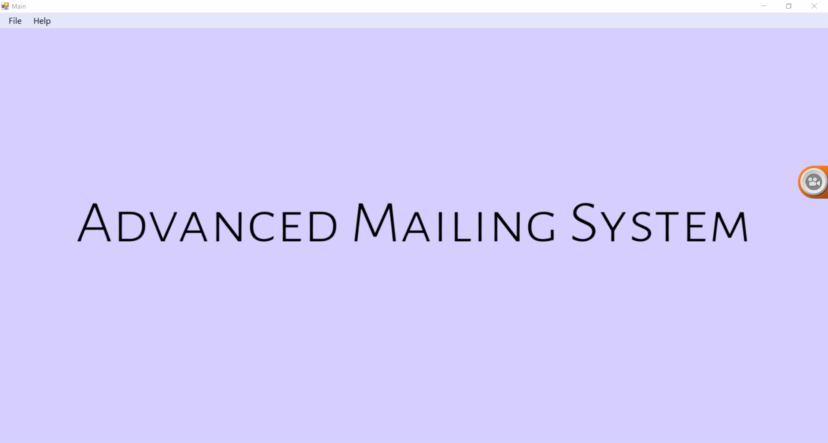

Slide 13
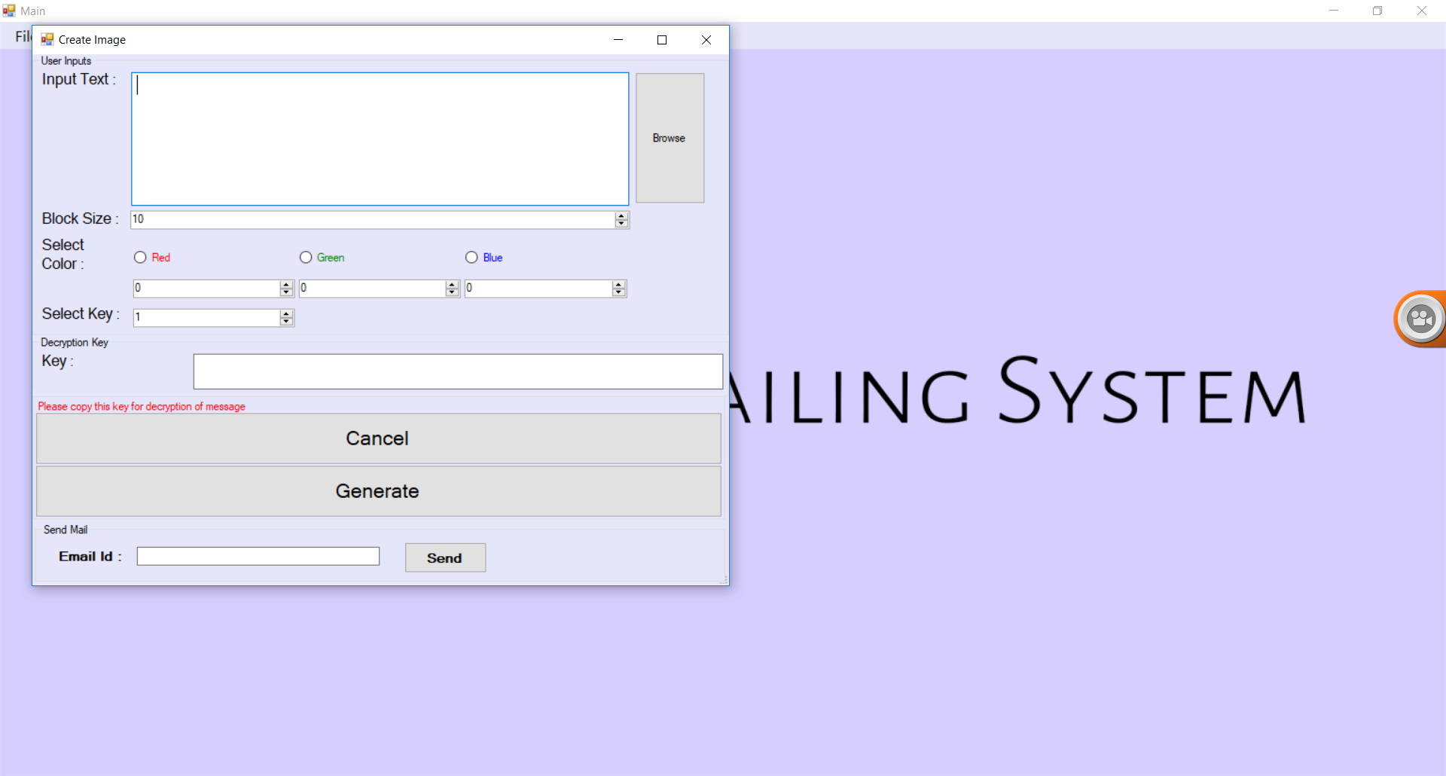

Slide 14
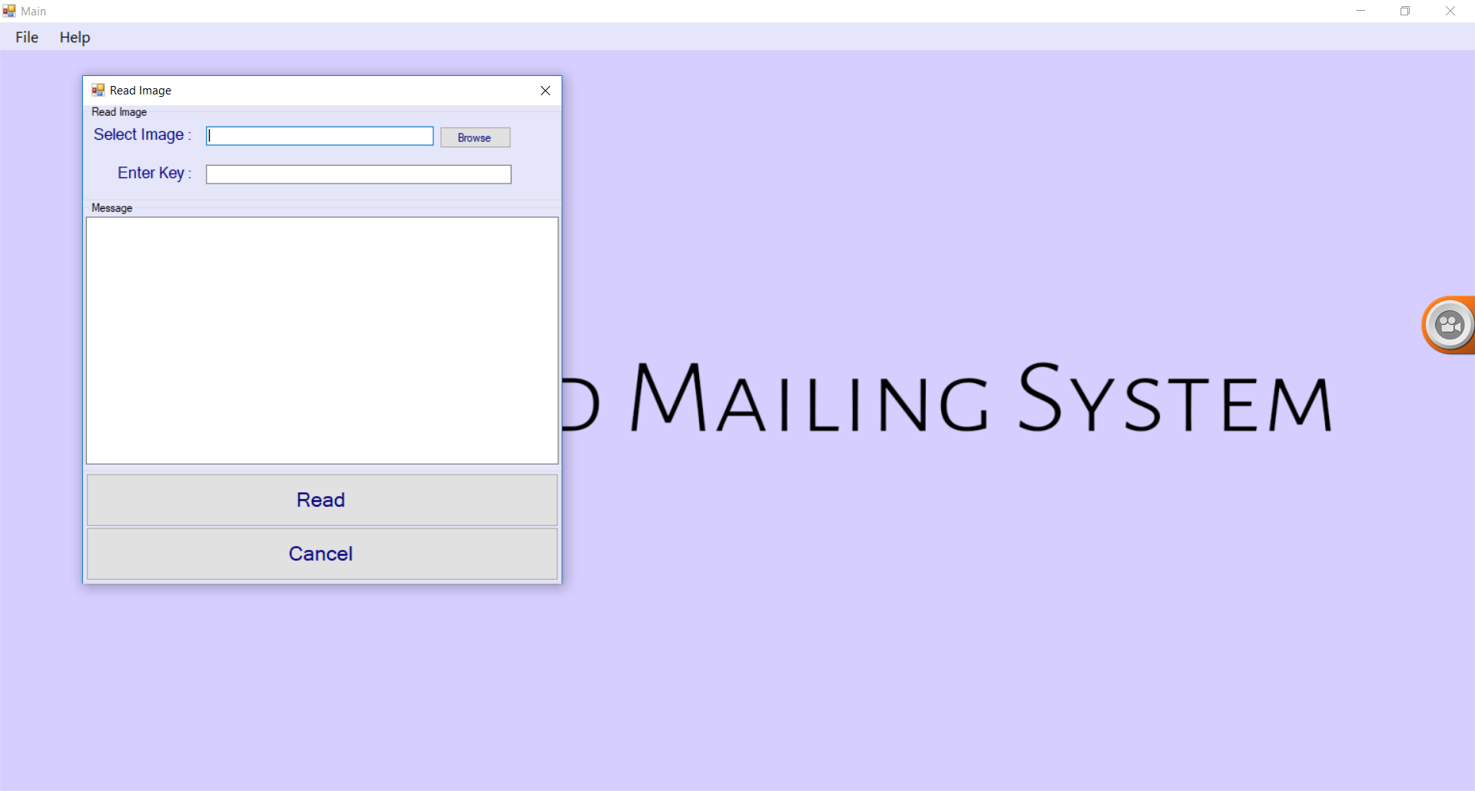

Slide 15
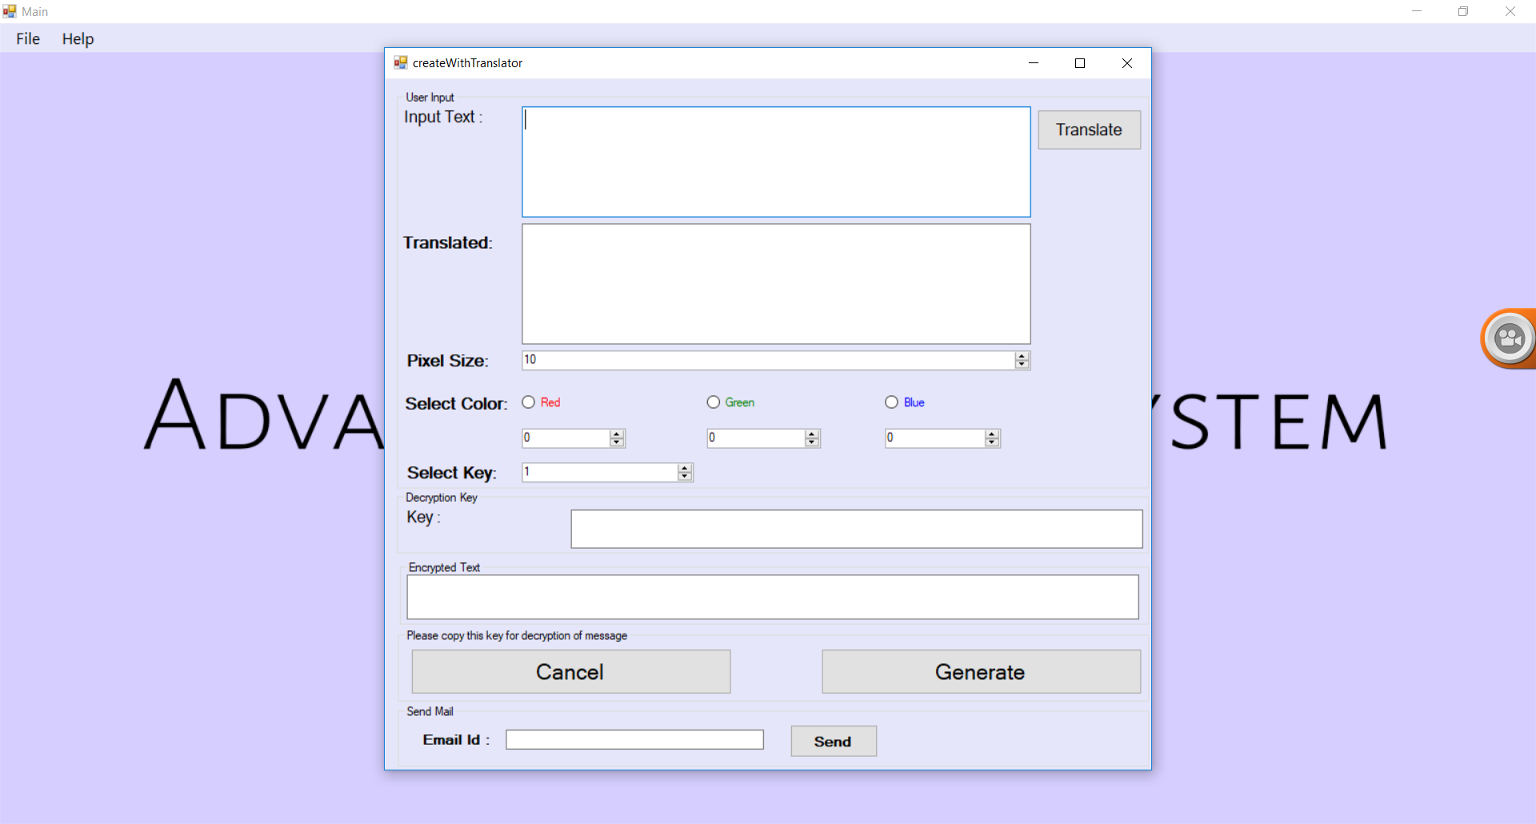

Slide 16
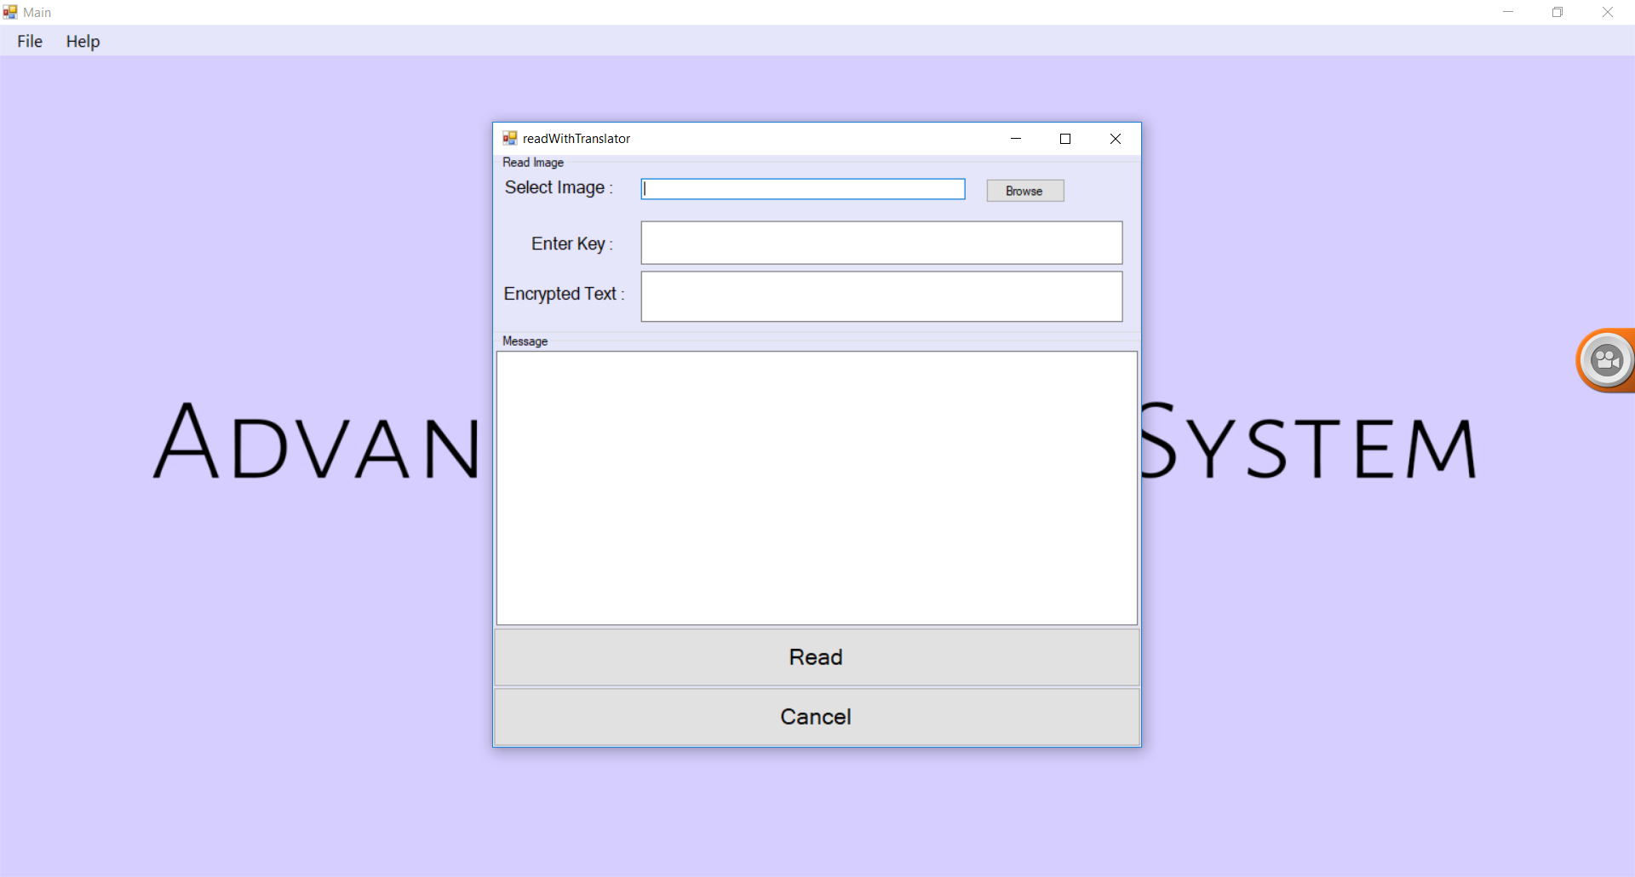

Slide 17
Questions? Thank You.

